Slide 1

Introduction to Artificial Intelligence Group 1 Week 1
Dr. Juan Carlos Rojas
Juan-Carlos.Rojas@ttu.edu

Slide 2
Introductions

Slide 3
















Juan Carlos Rojas
Notes:
About me:
History:
I grew-up and studied in Costa Rica at UCR (EE)
Management experience:
4 years as DSP manager at 2Wire
4 years running Inband Software
Master’s degree in Engineering Management

Slide 4
Assistant: Edward Sánchez
Attendance
Assisting during practices
Grading homeworks

Slide 5
Participant Affiliations
Accenture S.R.L.
Akamai Technologies Costa Rica, S.R.L.
BAC Credomatic S.A.
Banco Promerica de Costa Rica S.A.
BASS Americas S.A.
Boston Scientific de Costa Rica, S.R.L.
Cable Visión de Costa Rica CVCR S.A.
Componentes Intel de Costa Rica S.A.
Consultor Independiente
Consultores en Sistemas Informáticos de Costa Rica S.A.
CONTINEX S.A.
DARWIN ZONE, S.A.
ENTCO Costa Rica Limitada
EntServ Costa Rica Limitada
Establishment Labs
GBM Costa Rica, S.A.
Geo Ingeniería Ingenieros Consultores S.A.
GFT Costa Rica
Gorilla Logic S.R.L.
Growth Acceleration Partners S.A.
Grupo Empresarial GE Trescientos Sesenta, S.R.L.
Grupo Mutual
Kimberly Clark
L.L. Bean, Inc
Lion Resources S.A.
P&G International Operations S.A.
Pernix S.A.
Radio Coverage S.R.L.
Real Time Consulting S.A.
Sistemas Galileo del Sur BC S.A.
Soin Soluciones Integralas S.A.
TAU Technologies AI de Latinoamérica S.A
Triquimas S.A.
Unión del Oeste de Costa Rica S.R.L.
VMware Costa Rica Limitada

Slide 6
Class Logistics

Slide 7
WiFi
SSID: TTUAI
Password: ttuai2019

Slide 8
Class Methodology
Alternating blocks of lecture and guided practice
~30 minutes each
Lecture
Explanations about theory, tools and methodologies
Feel free to interrupt and ask questions at any time
Practice
Demonstration examples
Individual assigments to be completed in class
Homework
Based on class assignments, a bit more in-depth
One per week, due before next class

Slide 9
Course Materials
Available on shared OneDrive: Course Materials
New materials posted weekly
Includes:
Presentations
Data files
Code samples

Slide 10

Homework Submissions
A Dropbox file request link will be sent for each assignment
You will get it by e-mail
Please submit a single ZIP file with:
Your code
A brief report with your results (screen shots, console logs)
Do not submit the data files

Slide 11
Evaluation
Attendance: 30%
7 homeworks: 70%
Passing grade is 70

Slide 12
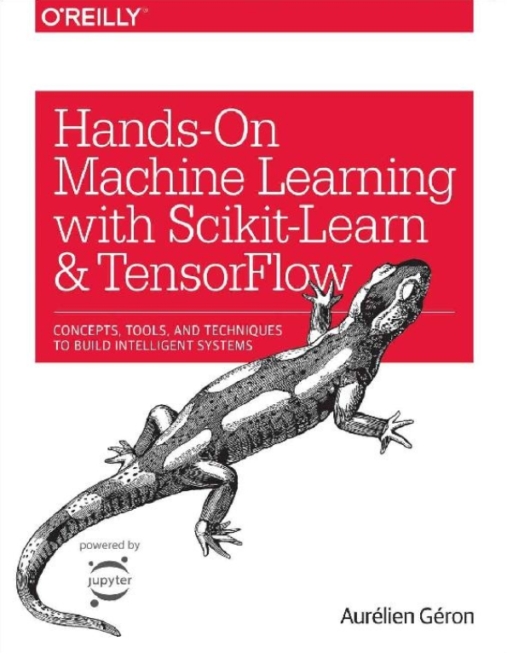
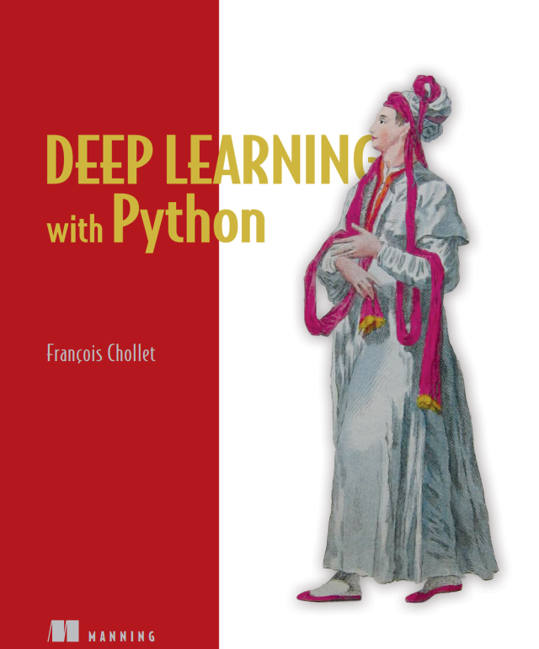
References

Slide 13
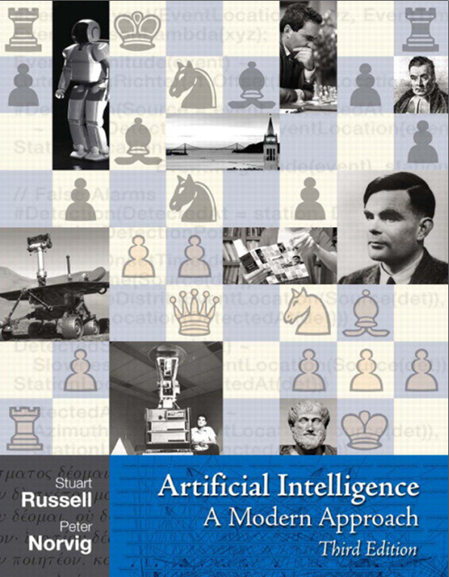
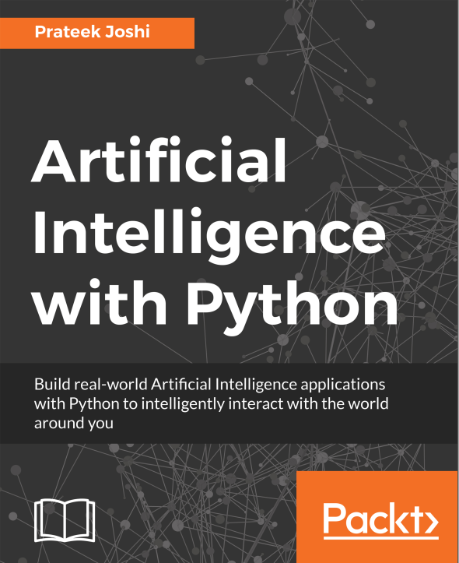
References

Slide 14
Schedule
Date | Class | HW Assigned | HW Due
May 18 | Class 1 | HW1
May 25 | Class 2 | HW2 | HW1
June 1 | Class 3 | HW3 | HW2
June 8 | Class 4 | HW4 | HW3
June 15 | No class
June 22 | Class 5 | HW5 | HW4
June 29 | Class 6 | HW6 | HW5
July 6 | Class 7 | HW7 | HW6
July 13 | Class 8 |  | HW7

Slide 15
Agenda for Week 1
Theory
Overview of artificial intelligence
AI approaches and methods
Machine learning
Supervised machine learning
Practice
Python basics
Plotting
NumPy arrays
Pandas dataframes
Data exploration
Linear regression with 1 variable

Slide 16
Overview of Artificial Intelligence

Slide 17

What is Artificial Intelligence?
A way to make machines behave intelligently
Act Humanly
Understand the world and react in a way that is similar to how humans do it
Natural language processing
Knowledge representation
Automated reasoning
i.e. Chat-bots, Turing test
Act Rationally
Rational agents
Operate autonomously
Perceive environment
Adapt and pursue goals
i.e. Robots in Mars

Slide 18
Why Use Artificial Intelligence?
Humans have a limited capacity to process large amounts of data
Computers are better at this
The reaction time of computers can be faster
Some applications require very quick actions
i.e. autonomous driving, stock trading
Humans don´t enjoy repetitive tasks
Computers don´t mind

Slide 19
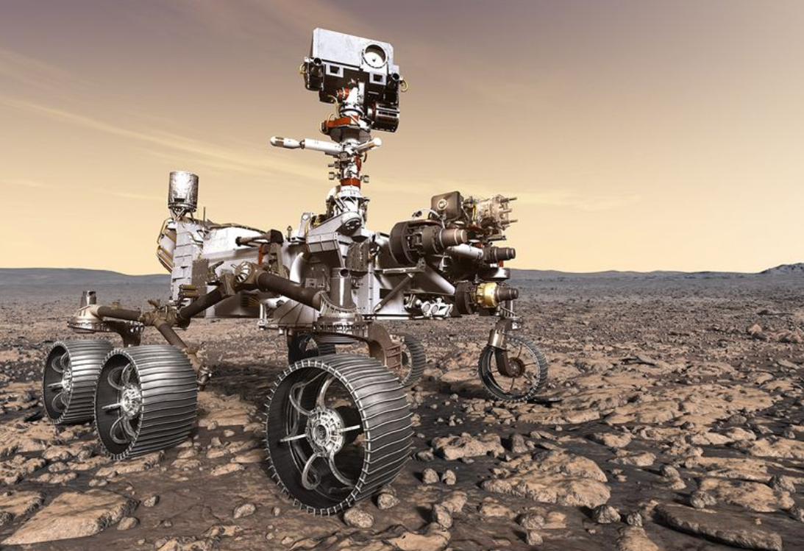
Some Applications of AI
Spam identification
Recommendation engines
Speech recognition
Natural language processing
Translation
Face recognition
Text character recognition
Stock market prediction
Credit risk estimation
Exploration of unknown environments

Slide 20
History of AI
1960s:
Rule-based AI used in limited applications (playing Checkers, proving theorems)
Research on shallow neural networks (perceptrons)
1970s:
Machine learning used in optical character recognition (OCR) other specialized applications
Expert systems successfully predict molecular structures of mass spectrometer readings
1980s:
High commercial investment in rule-based expert systems
Machine learning used commercially for hand-written digit recognition (mail sorting)
Back-propagation algorithm for training of deep networks

Slide 21
History of AI
1990s:
Machine learning shows success in spam filters, takes off in popularity
IBM Deep Blue defeats Chess world champion Gary Kasparov
Research in support vector machine classifiers, general intelligent agents
2000s:
Cloud enables storage of larger datasets and distributed processing
Breakthroughs in robotic vehicles, speech recognition, translation
Research in decision tree and random forest classifiers
2010s:
Deep neural networks show breakthrough results for image classification
GPU acceleration of neural networks
Deep neural networks fuel commercial success in speech recognition, natural language processing, translation, etc.
Research in autonomous driving, convolutional neural networks

Slide 22
Python Basics

Slide 23
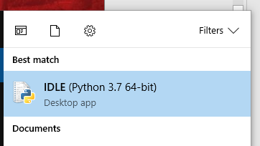
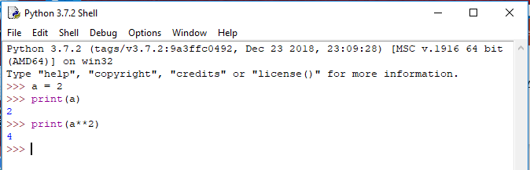
Creating and Running Python Programs
The IDLE interactive shell
Can run instructions line-by-line
Results stay in the environment
Useful for quick tests

Slide 24
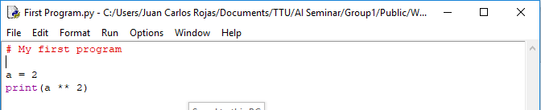
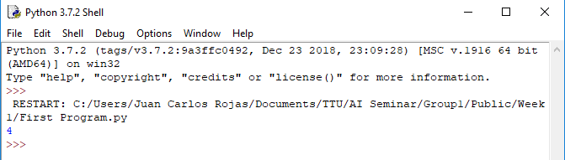
Creating and Running Python Programs
Python programs (scripts)
Text files with .py extensions
Can be created and edited with IDLE (File -> New File)
Can be run from IDLE (Run –> Run Module)
Results show up in the Shell

Slide 25
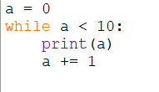
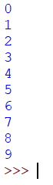
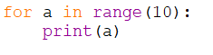
Loops
While loops iterate as long as a condition is met:
For loops iterate over a group of items
Using range(n) is a useful way to create a sequence of numbers

Slide 26
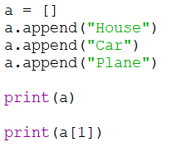
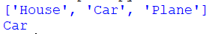
Lists
Lists are a built-in type in Python
Can store any kind of object (numbers, strings, etc.)
Use mylist = [] to create an empty list
Use mylist.append(x) to add x to mylist
Use a = mylist[i] to read the list at index i
Use mylist[i] = b to update the value at index i

Slide 27
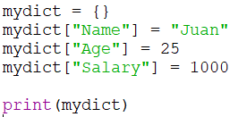
Dictionaries
A collection of key-value pairs
They key is the identifier, the value can be any type, even lists
Use mydict = {} to create an empty dictionary
Use mydict[k] = v to add an element with key k and value v

Slide 28
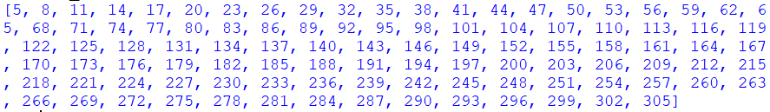
Practice 1
Create a Python program that:
Creates a list x with values between 0 and 100
Creates a list y with values derived from x like this:
y[i] = x[i] * 3 + 5
Prints y

Slide 29
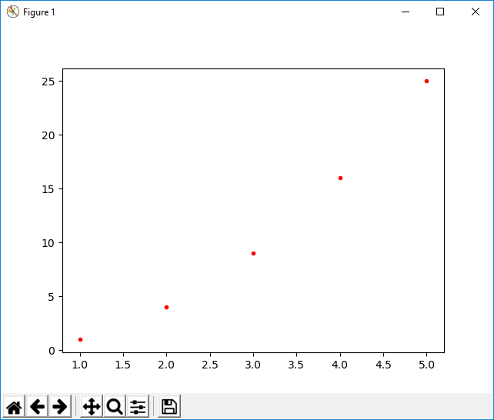
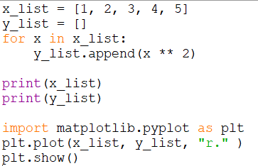
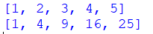
Plotting with Matplotlib
A rich plotting library inspired by Matlab
Scatter (XY) plots:

Slide 30
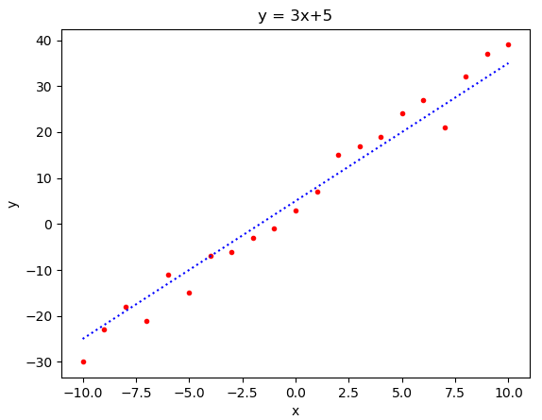
Practice 2
Create a Python program that plots the function y = 3x + 5, for a range of values of x in [-10, +10].
Repeat part a), but his time add a random value of +/-5 to each value of y. Plot the values in an x-y plot (a scatter plot).
Combine a) and b) to plot the scatter plot with the trend line on top.

Slide 31
AI Approaches and Methods

Slide 32

Common Approaches to AI
Rules-based
Exhaustive search
Heuristics
Genetic algorithms
Expert systems
Rational agents
Machine learning

Slide 33
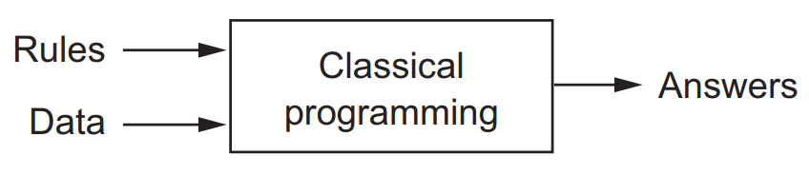
Rules-Based AI
A.I.
For problems that can be described by a set of logic rules
For example:
Proving theorems
Simple games
Rules are programmed (by a human)
The computer simply follows the rules

Slide 34

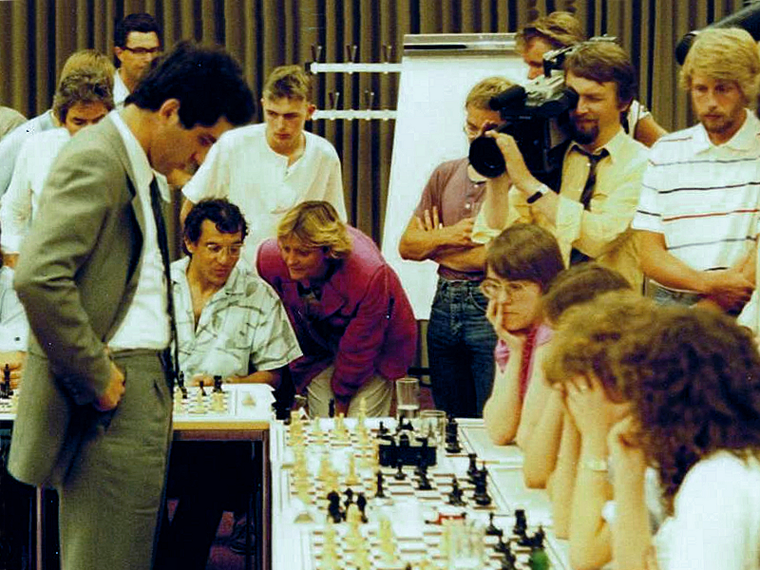
Exhaustive Search
Brute-force approach
Examine as many possibilities and pick the best
Requires efficient search algorithms
Examples:
Chess
Web search

Slide 35

Heuristic Rules
Techniques provided by humans that appear to work well
Educated guesses
Not guaranteed to be optimal
Appropriate when exhaustive search is not feasible
Examples:
Virus detection
Relevance rankings in search results

Slide 36

Genetic Algorithms
Useful when full search is not feasible
Allows getting out of local optima in heuristic search
Create random variations of previous solutions and selecting the best
Akin to survival of the fittest
Examples:
Resource schedulers

Slide 37
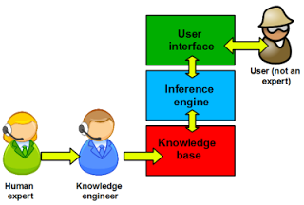
Expert Systems
Relies on a stored knowledge base
Facts
Heuristic rules
Uses an Inference Engine to solve new problems
Based on if-then-else rules
Focused on a specific purpose
For example:
Medical diagnostics
Technical support
Gained commercial success in 1980s

Slide 38
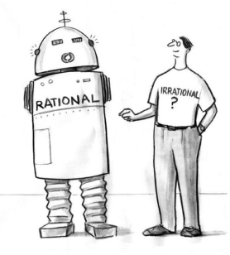
Rational Agents
Inspired by Economics theories of behavior
Seek to achieve goals under uncertain conditions
Maximizes metrics of benefit
How close it gets to achieve its goals
Example:
Robots exploring an unknown environment

Slide 39
NumPy & Pandas

Slide 40

NumPy
A library to manipulate arrays (matrices and vectors)
Uses objects of class ndarray
To create arrays:
Use np.array() to convert from regular Python lists
Use np.zeros(), np.ones(), np.arange() to create fixed-size arrays
Use np.reshape() to change shape (i.e. vector to matrix)

Slide 41
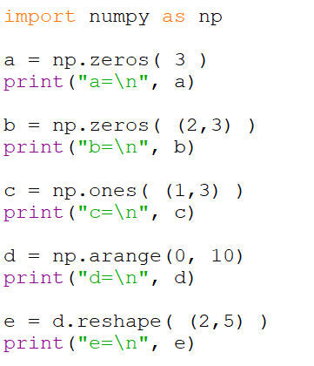
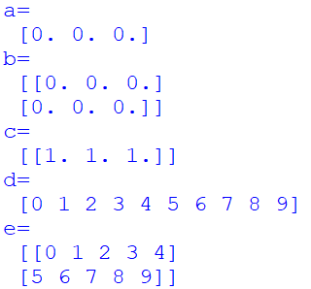
NumPy Array Creation

Slide 42
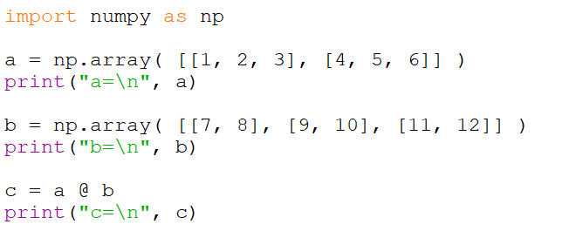
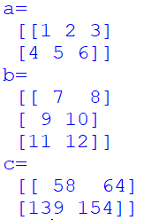
NumPy Matrix Operations
Matrix multiplication: x @ y

Slide 43
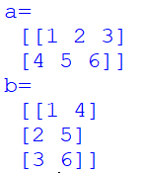
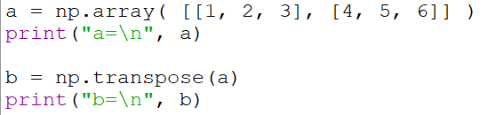
NumPy Matrix Operations
Matrix transposition: np.transpose(x)

Slide 44
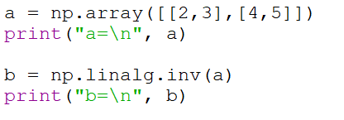
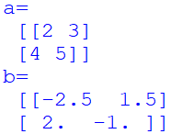
NumPy Matrix Operations
Matrix inversion: np.linalg.inv(x)

Slide 45
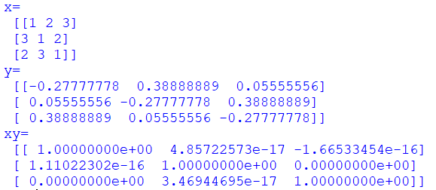
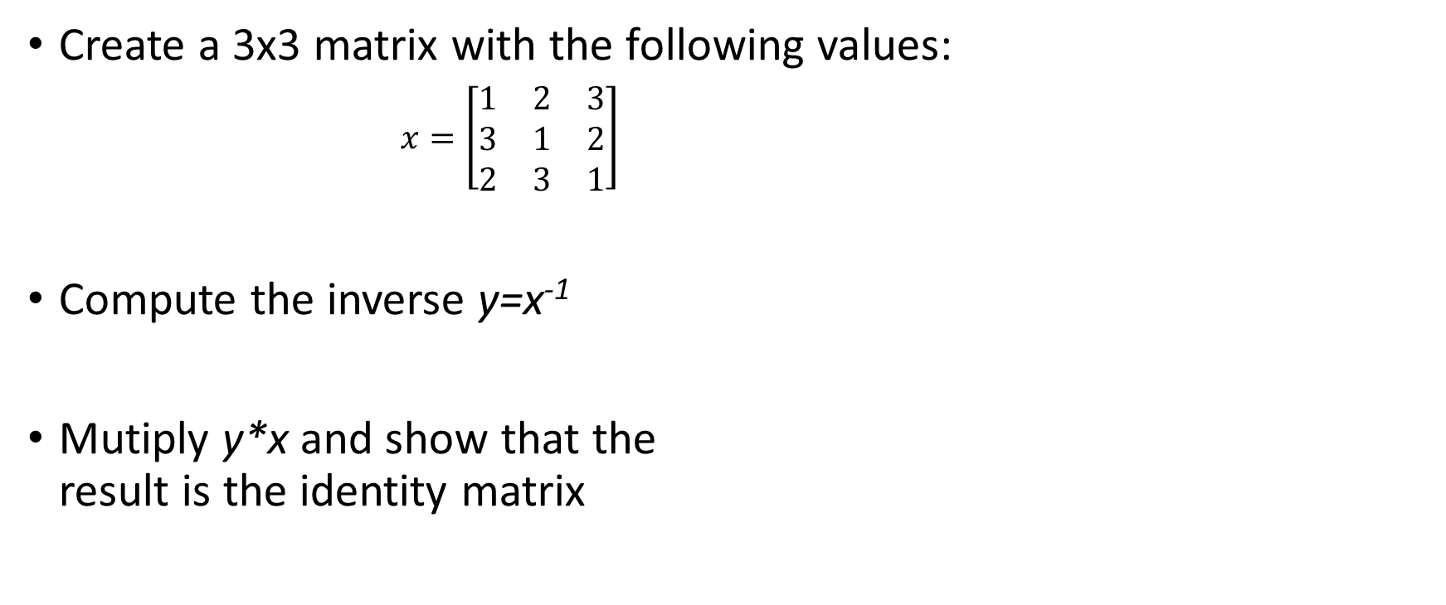
Practice 3
Create a 3x3 matrix with the following values:
$x=\left[\begin{matrix}1 & 2 & 3 \\ 3 & 1 & 2 \\ 2 & 3 & 1\end{matrix}\right]$
Compute the inverse y=x⁻¹
Mutiply y*x and show that the result is the identity matrix

Slide 46

Pandas Dataframes
A structured collection of data arranged by named columns
Useful for datasets with multiple attributes
Data columns are most commonly NumPy arrays

Slide 47
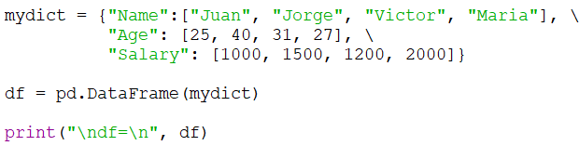
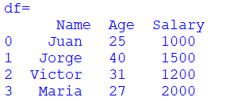
Creating a Dataframe
From a dictionary of lists or ndarrays:

Slide 48
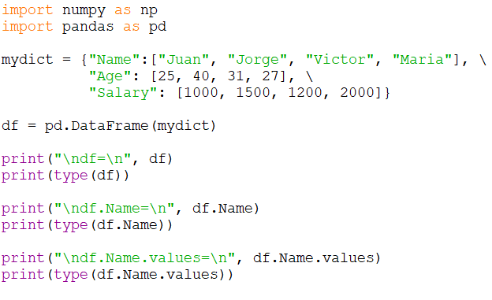
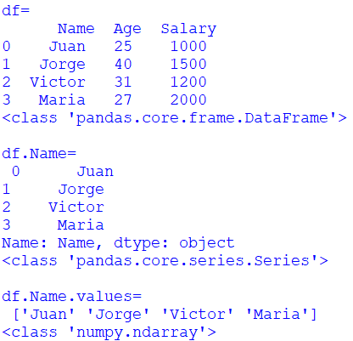
Accessing Columns
Use df.col_name to access a single column of data
Or df[“col_name”]

Slide 49
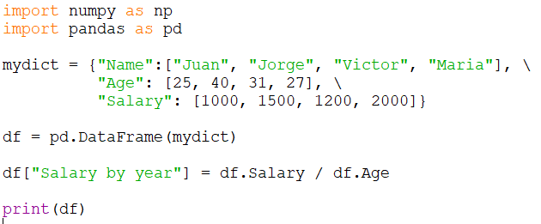
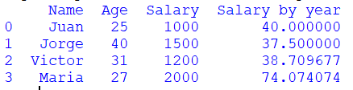
Deriving Columns
You can perform vector computations on columns
Use df[“col_name”] = x to add a new column

Slide 50
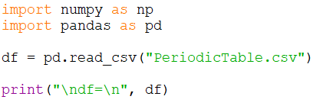
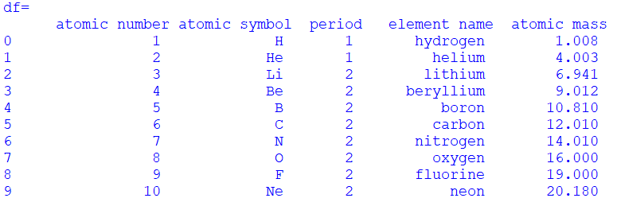
Reading from a CSV File
Use df = pd.read_csv(‘file.csv’) to read a CSV file into a dataframe

Slide 51
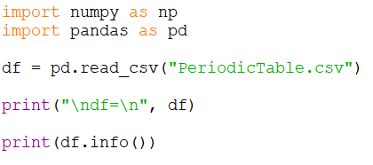
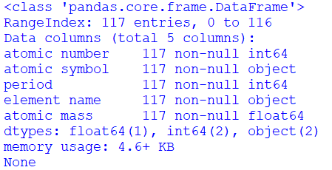
Dataframe Info
df.info() provides a summary of the dataframe contents

Slide 52
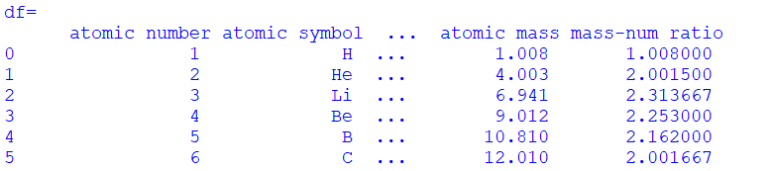
Practice 4
Read the periodic table CSV file (PeriodicTable.csv) into a Pandas dataframe
Create a column that computes the ratio between the atomic mass and the atomic number

Slide 53

Break

Slide 54
Machine Learning

Slide 55
Machine Learning
Learns pattern & rules from the data (knowledge base)
Makes predictions from new data
Knowledge Base
Data
Learning Model
Knowledge Base
New Data
Predictions
Inference Engine

Slide 56
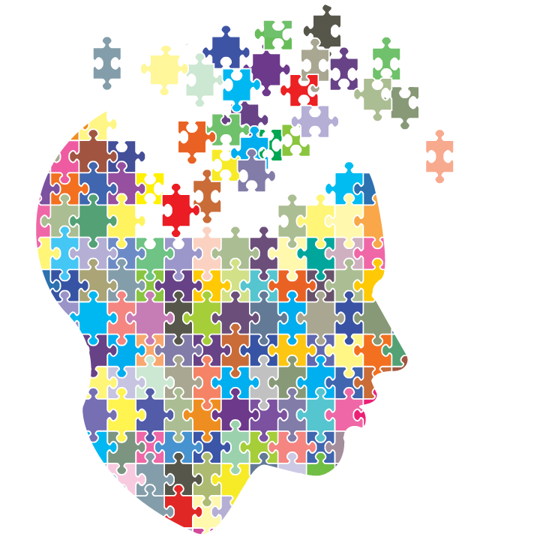
Learning Models
The techniques used to learn the patterns & rules from the data
Supervised
We have the expected outputs (labels) for the training examples
Unsupervised
We don’t have labels
Need to make inferences based on similarity of data
Semi-supervised
We have some labels, but not for all examples
Reinforcement learning
We are learning by interacting with the environment
Outcomes of past decisions influence future decisions

Slide 57

Inference Engine
Capable of making predictions given new data
Instance-based
Looks for similarities with respect to memorized examples
Model-based
Uses abstract mathematical representations of the patterns

Slide 58
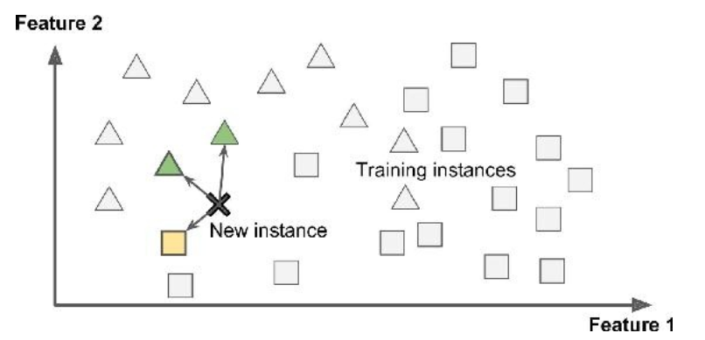
Instance-Based Learning
The system memorizes all the examples
Then classifies new instances by how similar they are to the known examples

Slide 59
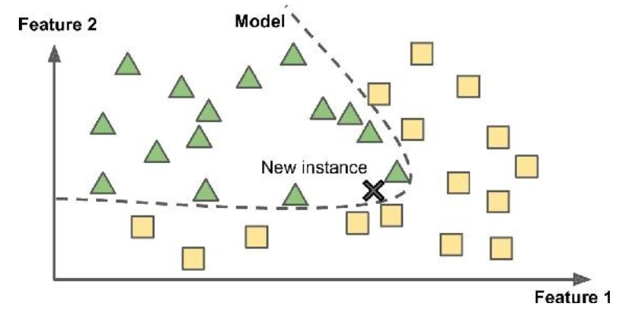
Model-Based Learning
Creates an abstract model that fits the data
The model is then used to make predictions

Slide 60
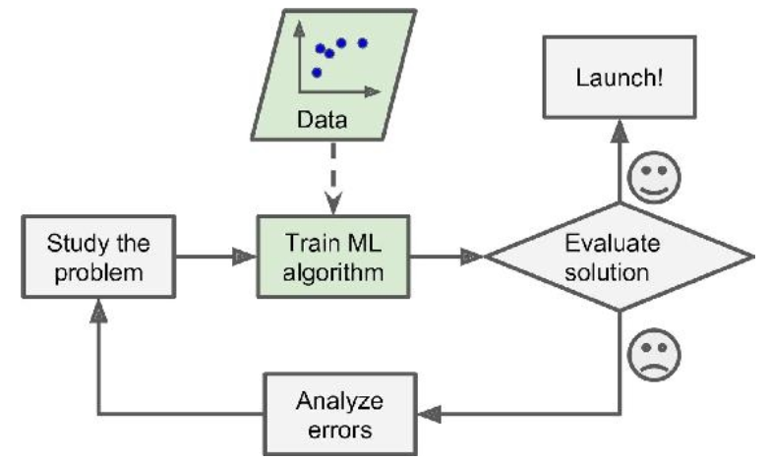
Advantages of Machine Learning
Not limited by human intuition
Patterns come from the data
Uses scientific approach to data analysis

Slide 61
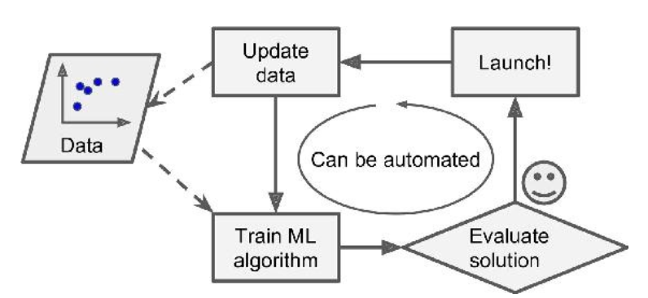
Advantages of Machine Learning
Adaptability
Can evolve as the environment changes
The model can be automatically re-created or updated to new data
i.e. spam detection, virus detection

Slide 62

Advantages of Machine Learning
Provides Insights
Trained models represent patterns in the data
Visualization of trained models can provide humans insights into patterns
Important for data analytics

Slide 63

Types of Estimation
There are two kinds of estimation that inference engines will produce:
Regression
Classification

Slide 64

Regression
Provides a value of an outcome, based on input data
Usually related to prediction (predict future values)
Examples:
Home values
Stock market values

Slide 65

Classification
Arranges cases between several possible classes or categories (mutually exclusive)
Examples:
Image recognition (i.e. hand-written digits)
Speech recognition
You can use regression as a basis for classification
i.e. the output can be a probability value of belonging to a given class

Slide 66


Slide 67
Exploring Data

Slide 68
The Vehicle Price Dataset
This is a data set of 107,713 ads of vehicles for sale
Includes price, make, model, year, odometer, drive, etc.
Based on Craigslist Cars+Trucks Data
https://www.kaggle.com/austinreese/craigslist-carstrucks-data
Cleaned-up by JCR
Limited range of years: 2000+
Limited range of prices: $1,000 - $50,000
Removed incomplete entries
Removed severe outliers

Slide 69


Reading the Dataset

Slide 70


Exploring the Dataset

Slide 71

Exploring Numerical Columns
It is useful to explore the distribution of values in numerical columns using histograms
Pandas has a very handy histogram function:
df[col].hist(bins=50)
Or df.hist(column=[“col"], bins=50)
plt.show()

Slide 72


Practice 5
Read the vehicle price dataset (craigslistVehicles.csv) into a Pandas dataframe
Plot a histogram of each of the numeric variables (year, odometer, price) using 50 bins

Slide 73

Exploring Relationships
We can use scatter plots (x-y plots) to visualize the correlation between numerical columns
i.e. price vs. year

Slide 74

Practice 6
Read the vehicle price dataset (craigslistVehicles.csv) into a Pandas dataframe
Plot a scatterplot of price vs. year
Plot a scatterplot of price vs. odometer

Slide 75


Exploring Categorical Columns
Visualizing categorical columns is a bit more involved
A good way to visualize the distribution of values is to use bar graphs of the counts of each category
See Vehicle Price Explore Categorical 1.py

Slide 76


Exploring Relationships w.r.t Categorical
A boxplot split by category is a great way to visualize this kind of relationship
i.e. price vs. condition
The seaborn module is particularly good at this kind of plot
See Vehicle Price Explore Categorical 2.py

Slide 77

Exploring Relationships w.r.t Numerical, Take Two
When distributions are spread, a better way to explore relationships is to discretize the numerical variables into bins, then use boxplots

Slide 78

Exploring Relationships w.r.t Numerical, Take Two
See Vehicle Price Explore Numerical 2.py

Slide 79
Supervised Machine Learning

Slide 80
Supervised Machine Learning Model
Uses a set of training data that has the correct answers (labels)
Derives the knowledge base (patterns & rules) from the data
Machine Learning Algorithm
Training Data
Knowledge Base
Labels

Slide 81

Training Data & Labels
Each training example is associated with a label
A known-good answer
Can be either a numeric value, or a class
Generally we need a large number of examples in the training set
The knowledge model will represent general patterns in the data
Will be able to predict labels for new instances

Slide 82

How to Obtain the Training Labels?
The labels need to be “known-good”
The challenge is to get them in high volume
Labels can come from:
Human expertise
Historical records
Tagged images
reCAPTCHA
Crowd-sourcing efforts
From the reaction of the environment to experiments
User reaction to recommendations
Winning plays in Chess

Slide 83

Batch Learning
Trains model with all available training data
Provides a predictable model for a given data set
Good for developing the algorithm (keeps inputs constant)
Does not adapt to new data

Slide 84

Incremental Learning
Breaks the training data into mini-batches
Improves the model incrementally
Provides method for adaptation to new data
Just keep training incrementally with each new mini-batch
Don’t need to re-train with all the data every time we need an update
The learning rate is a key design parameter

Slide 85

Machine Learning Algorithms
Linear regression
Logistic regression
Support vector machines
Decision trees
K-nearest neighbor
Neural networks
Etc.

Slide 86
Linear Regression

Slide 87



Linear Regression Model
Predicts the output as a linear combination of the input:
$$y=θ_{1}x+θ_{0}$$
Works well when the output and input are roughly proportional

Slide 88


Linear Regression Examples

Slide 89



Multivariate Linear Regression
The linear regression model can be extended to multiple input variables by adding more coefficients
If you set x₀=1, then you can express it as
Or in matrix form:
$y=θ_{0}+θ_{1}x_{1}+$ $θ_{2}x_{2}+…+$ $θ_{n}x_{n}$
$$y=\sum_{i=0}^{n}{θ_{i}x_{i}}$$
$$y=θ^{T}∙X$$

Slide 90

The Normal Equations
A closed-form solution for the coefficients that minimizes the mean-squared error (MSE) of the prediction w.r.t a series of observations
X is a matrix with:
One column of ones
One column per variable
One row per data example
y is a vector with one label per example

Slide 91

Solving the Normal Equations with NumPy Arrays
See VehiclePrice_LinearRegression_1Var_1.py

Slide 92


Viewing One-Variable Regression
To make sure the regression model is correct, we can plot the trendline over the scatterplot
See VehiclePrice_LinearRegression_1Var_2.py

Slide 93

Practice 7
Solve the Normal Equations to compute a linear-fit model for price vs. odometer of the form: y = m*x + b, where x is the vector of odometer values, and y is the vector of prices.
m should be a single coefficient
b should be a single value for the intersection
Plot the scatterplot of price vs. odometer, with the best fit trendline on top

Slide 94

Extra Challenge
Plot the trendline on top of a boxplot
Hint: need to manipulate the x values to align (they have a different scale)

Slide 95

Extra Challenge

Slide 96
Thank you

